Slide 1
Math 10C
Student Notes and Examples
Topic: Linear Functions

Slide 2
Relations and Functions
5.1: Slope of a Line
Linear Relation:
A relation that forms a straight line when the data are plotted on a graph
Linear
Discrete data
Linear
Continuous data
Non-Linear

Slide 3
Slope:
$$m=\frac{rise}{run}$$
$$run=2$$
$$m=\frac{3}{2}$$
$$rise=3$$
$$m=\frac{−6}{−4}=\frac{3}{2}$$
$$rise=−6$$
$$run=−4$$
An important characteristic of a linear relation is that it has a constant slope.

Slide 4
Slope:
$$m=\frac{y_{2}−y_{1}}{x_{2}−x_{1}}$$
$$(3, 5)$$
$$m=\frac{5−2}{3−1}=\frac{3}{2}$$
$$(1, 2)$$
$$m=\frac{2−(−4)}{1−(−3)}=\frac{6}{4}=\frac{3}{2}$$
$$m=\frac{5−(−4)}{3−(−3)}=\frac{9}{6}=\frac{3}{2}$$
$$(−3, −4)$$
An important characteristic of a linear relation is that it has a constant slope.

Slide 5
Slope:
$$m=\frac{rise}{run}$$
$$run=−200$$
$$20$$
$$m=\frac{−8}{80}=\frac{−1}{10}$$
$$rise=−8$$
$$rise=20$$
$$m=\frac{20}{−200}=\frac{1}{−10}$$
$$10$$
$$run=80$$
$$100$$
$$200$$
An important characteristic of a linear relation is that it has a constant slope.

Slide 6
Slope:
$$m=\frac{y_{2}−y_{1}}{x_{2}−x_{1}}$$
$$(0, 20)$$
$$20$$
$$m=\frac{20−12}{0−80}=\frac{8}{−80}=\frac{1}{−10}$$
$$m=\frac{12−0}{80−200}=\frac{12}{−120}=\frac{1}{−10}$$
$$(80, 12)$$
$$10$$
$$m=\frac{20−0}{0−200}=\frac{20}{−200}=\frac{1}{−10}$$
$$(200, 0)$$
$$100$$
$$200$$
An important characteristic of a linear relation is that it has a constant slope.

Slide 7
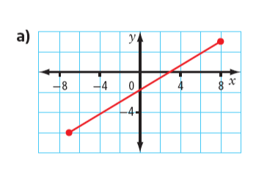
Slope is calculated by finding the ratio of the "vertical change" to the "horizontal change" between (any) two distinct points on a line.
Example #1: Find the slope of each line
$$m=\frac{rise}{run}$$
$$m=\frac{9}{15}=$$
$$(8,3)$$
$$\frac{3}{5}$$
$$rise=9$$
$$(−7, −6)$$
$$m=\frac{y_{2}−y_{1}}{x_{2}−x_{1}}$$
$$run=15$$
$$m=\frac{3−(−6)}{8−(−7)}=$$
$$\frac{9}{15}=$$
$$\frac{3}{5}$$

Slide 8
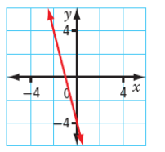
Example #1: Find the slope of each line
$$m=\frac{rise}{run}$$
$$m=\frac{−8}{2}=$$
$$−4$$
$$rise=−8$$
$$(−2,4)$$
$$(0, −4)$$
$$m=\frac{y_{2}−y_{1}}{x_{2}−x_{1}}$$
$$run=2$$
$$m=\frac{4−(−4)}{−2−0}=$$
$$\frac{8}{−2}=$$
$$−4$$

Slide 9
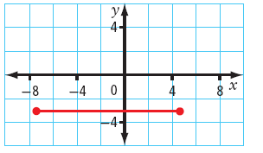
Example #1: Find the slope of each line
$$m=\frac{rise}{run}$$
$$m=\frac{0}{run}=$$
$$0$$
$$rise=0$$
$$(−4,−3)$$
$$(−1, −3)$$
$$m=\frac{y_{2}−y_{1}}{x_{2}−x_{1}}$$
$$m=\frac{−3−(−3)}{−4−(−1)}=$$
$$\frac{0}{−3}=$$
$$0$$
All horizontal lines will have a slope of zero

Slide 10
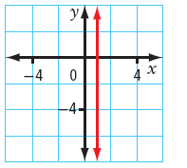
Example #1: Find the slope of each line
$$run=0$$
$$m=\frac{rise}{run}$$
$$(1,2)$$
$$m=\frac{rise}{0}=$$
$$undefined$$
$$(1, −4)$$
$$m=\frac{y_{2}−y_{1}}{x_{2}−x_{1}}$$
$$m=\frac{2−(−4)}{1−1}=$$
$$\frac{6}{0}=$$
$$undefined$$
All vertical lines will have a slope which is undefined

Slide 11
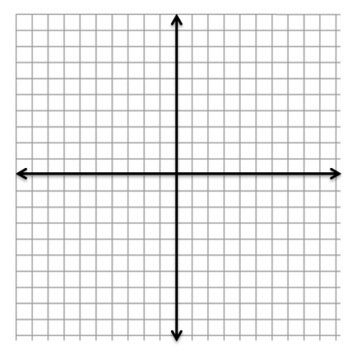
Classifying Slope
Positive slope
Negative slope
All lines higher on the right
will have positive slopes
All lines higher on the left
will have negative slopes

Slide 12
Classifying Slope
Zero slope
Undefined slope
All horizontal lines will have a slope of zero
All vertical lines will have slopes that are undefined

Slide 13
Example #2: For each pair of points, graph the line and calculate the slope.
A line passes through $(−3, 7) and (9, −1)$
$$m=\frac{rise}{run}$$
$$m=\frac{−8}{12}=−\frac{2}{3}$$
$$rise=−8$$
$$m=\frac{y_{2}−y_{1}}{x_{2}−x_{1}}$$
$$m=\frac{7−(−1)}{−3−9}$$
$$run=12$$
$$=\frac{8}{−12}$$
$$=−\frac{2}{3}$$

Slide 14
Example #2: For each pair of points, graph the line and calculate the slope.
A line passes through $(−10, −10) and (10, −10)$
$$m=\frac{rise}{run}$$
$$m=\frac{0}{20}=0$$
$$m=\frac{y_{2}−y_{1}}{x_{2}−x_{1}}$$
$$m=\frac{−10−(−10)}{−10−10}$$
$$=\frac{0}{−20}$$
$$run=20$$
$$=0$$

Slide 15
Example #2: For each pair of points, graph the line and calculate the slope.
A line passes through $(−3, −5) and (6, 7)$
$$m=\frac{rise}{run}$$
$$run=9$$
$$m=\frac{12}{9}=\frac{4}{3}$$
$$rise=12$$
$$m=\frac{y_{2}−y_{1}}{x_{2}−x_{1}}$$
$$m=\frac{−5−7}{−3−6}$$
$$=\frac{−12}{−9}$$
$$=\frac{4}{3}$$

Slide 16
Example #3: Draw each of the following lines, given the slope and a point
on the line.
Slope= $\frac{1}{3}$
Point = $(−4, −5)$
$$m=\frac{rise}{run}=\frac{1}{3}$$
$$run=3$$
$$rise=1$$

Slide 17
Example #3: Draw each of the following lines, given the slope and a point
on the line.
Slope= undefined
Point = $(6, −2)$

Slide 18
Example #3: Draw each of the following lines, given the slope and a point
on the line.
Slope= 0
Point = $(−8, 9)$

Slide 19
Example #4:
In 1800, the wood bison population in North America was estimated at 168 000. The population declined to only about 250 animals in 1893. What was the average rate of change in the bison population from 1800 to 1893?
$$(year, population)$$
$$(1800, 168 000)$$
$$(1893, 250)$$
$$m=\frac{y_{2}−y_{1}}{x_{2}−x_{1}}$$
$$m=\frac{168 000−250}{1800−1893}$$
$$=\frac{167 750}{−93}$$
$$≈−1804$$
The wood bison population is decreasing by about 1804 buffalo per year

Slide 20
Example #5: Calculate the slope
$$m=\frac{rise}{run}$$
$$m=\frac{6000 L}{120 min}$$
$=50 L/min$
$$(80, 4000)$$
$$rise=$$
$$6000$$
$$m=\frac{y_{2}−y_{1}}{x_{2}−x_{1}}$$
$$(20, 1000)$$
$$run=120$$
$$m=\frac{4000L−1000L}{80min−20min}$$
$$=\frac{3000 L}{60 min}=50 L/min$$
The tank is filling up 50 Litres per minute

Slide 21
Relations and Functions
5.2: Slope-Intercept Form
x- and y- Intercept
There are three main strategies for graphing lines: table of values,
x- and y- intercepts and using slope and a point.
Example #1: Graph the following equation using each method: $y=−2x+1$
Table of Values
x | y
– 2
1
4
$$5$$
$$−1$$
$$−7$$
$$y=−2\left(−2\right)+1=4+1=5$$
$$y=−2\left(1\right)+1=−2+1=−1$$
$$y=−2\left(4\right)+1=−8+1=−7$$

Slide 22
Relations and Functions
5.2: Slope-Intercept Form
Example #1: Graph the following equation using each method: $y=−2x+1$
x and y intercepts
y-axis
x | y
0
 | 0
$$1$$
$$0.5$$
y-intercept: x = 0
$$y=−2\left(0\right)+1=0+1=1$$
x-intercept: y = 0
x-axis
$$0=−2x+1$$
$$−1 −1$$
$$−1=−2x$$
$$\frac{−1}{−2}=\frac{−2x}{−2}$$
$$x=0.5$$

Slide 23
Slope-Intercept Form
The equation of a line may be written in slope intercept form: $y=mx+b$
$$If x=0 then y=m\left(0\right)+b$$
$$y=b$$
$$The y−intercept will always be (0, b)$$
The slope will always be m
$$y=\frac{2}{5}x+3$$
$$y=−\frac{4}{7}x$$
$$y=3x−5$$
$$y−intercept$$
$$(0, −5)$$
$$y−intercept$$
$$(0, 3)$$
$$y−intercept$$
$$(0, 0)$$
$$\frac{2}{5}$$
$$−\frac{4}{7}$$
Slope = m = 3
Slope = m =
Slope = m =

Slide 24
For each scenario, determine the slope and y-intercept and explain what they mean in the context of the problem.
An interior decorator's fee is given by:
$$F=60h+100$$
F- Fee ($) h- hours worked
Slope = 60
y-intercept is 100
The decorator charges $100 plus $60 per hour
T- Temperature (°C) t- time (mins)
The temperature of water is given by:
$$T=16t+20$$
Slope = 16
y-intercept is 20
The water started at 20 ºC then increased by 16 ºC per min

Slide 25
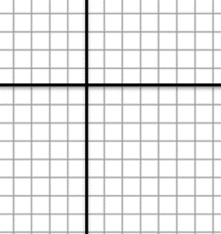
Example #2: Graph the following equation using each method: $y=3x−2$
Slope and a point
$$y=mx+b$$
$$y=3x−2$$
y-intercept: x = 0
$$run=1$$
$$y=3\left(0\right)−2=0−2=−2$$
$$rise=3$$
$$slope=m=3$$
$$m=\frac{3}{1}=\frac{rise}{run}$$

Slide 26
Example #2: Graph the following equation using each method: $y=−\frac{4}{3}x+1$
Slope and a point
$$y=mx+b$$
$$y=−\frac{4}{3}x+1$$
y-intercept: x = 0
$$y=−\frac{4}{3}\left(0\right)+1=0+1=1$$
$$(0, 1)$$
$$rise=−4$$
$$slope=m=\frac{−4}{3}$$
$$run=3$$

Slide 27
Relations and Functions
5.3: General Form
Another way to write an equation:
Slope-Intercept Form
General Form
$$y=4x−8$$
$$0=4x−y−8$$
If you wish to identify the slope and y-intercept of a line when it is in general form you must first re-arrange the equation into slope-intercept form (y = mx + b)

Slide 28
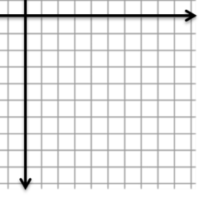
Example #1: Rewrite the following equations in slope-intercept form and graph the equation. $y=mx+b$
$$8x+y+2=0$$
$$y=−8x−2$$
$$(0, −2)$$
$$y−intercept =(0, −2)$$
$$Slope = m =\frac{−8}{1}$$
$$rise=−8$$
$$run= 1$$

Slide 29
Example #1: Rewrite the following equations in slope-intercept form and graph the equation. $y=mx+b$
$$3x+4y−12=0$$
$$4y=−3x+12$$
$$y=\frac{−3}{4}x+3$$
$$y−intercept =(0, 3)$$
$$(0, 3)$$
$$rise=−3$$
$$Slope = m =\frac{−3}{4}$$
$$run=4$$

Slide 30
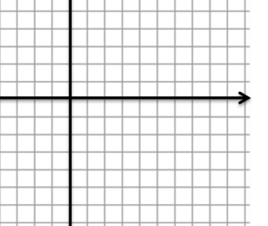
Example #1: Rewrite the following equations in slope-intercept form and graph the equation. $y=mx+b$
$$x−5y+10=0$$
$$−5y=−x−10$$
$$run=5$$
$$y=\frac{−1}{−5}x−\frac{10}{−5}$$
$$rise=1$$
$$(0, 2)$$
$$y=\frac{1}{5}x+2$$
$$y−intercept =(0, 2)$$
$$Slope = m =\frac{1}{5}$$

Slide 31
Example #1: Rewrite the following equations in slope-intercept form and graph the equation. $y=mx+b$
$$5x−3y−15=0$$
$$−3y=−5x+15$$
$$y=\frac{−5}{−3}x+\frac{15}{−3}$$
$$run=3$$
$$y=\frac{5}{3}x−5$$
$$y−intercept =(0,− 5)$$
$$rise=5$$
$$Slope = m =\frac{5}{3}$$
$$(0, −5)$$

Slide 32
You can also convert complex equations to general form:
$$y−2=−\frac{2}{5}\left(x+4\right)$$
Think about this
$$−5×−\frac{2}{5}=\frac{10}{5}=2$$
Multiply both sides of the equation by $−5$
$$−5\left(y−2\right)=−\frac{5}{1}×−\frac{2}{5}\left(x+4\right)$$
$$−\frac{5}{1}×−\frac{2}{5}=\frac{10}{5}=2$$
$$−5\left(y−2\right)=2\left(x+4\right)$$
$$−5y+10=2x+8$$
$$5y 5y$$
$$10=2x+5y+8$$
$$−10 −10$$
$$0=2x+5y−2$$

Slide 33
Relations and Functions
5.4: x- & y- intercepts
You can use the x- and y- intercepts to graph a line.
Example #1: Solve for the x- and y- intercept of the graph of each equation and then graph the line on the grid provided.
$$4x+3y=12$$
x-intercept: y = 0
y-intercept: x = 0
$$4x+3(0)=12$$
$$4(0)+3y=12$$
$$4x=12$$
$$3y=12$$
$$\frac{4x}{4}=\frac{12}{4}$$
$$\frac{3y}{3}=\frac{12}{3}$$
$$x=3$$
$$y=4$$

Slide 34
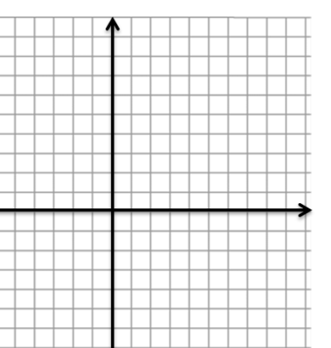
Relations and Functions
5.4: x- & y- intercepts
You can use the x- and y- intercepts to graph a line.
Example #1: Solve for the x- and y- intercept of the graph of each equation and then graph the line on the grid provided.
$$3x−5y=15$$
x-intercept: y = 0
y-intercept: x = 0
$$3x−5(0)=15$$
$$3\left(0\right)−5y=15$$
$$3x=15$$
$$−5y=15$$
$$\frac{3x}{3}=\frac{15}{3}$$
$$\frac{−5y}{−5}=\frac{15}{−5}$$
$$x=5$$
$$y=−3$$

Slide 35
Relations and Functions
5.4: x- & y- intercepts
You can use the x- and y- intercepts to graph a line.
Example #1: Solve for the x- and y- intercept of the graph of each equation and then graph the line on the grid provided.
$$−2x+16=8y$$
x-intercept: y = 0
y-intercept: x = 0
$$−2x+16=8(0)$$
$$−2\left(0\right)+16=8y$$
$$−2x+16=0$$
$$16=8y$$
$$−2x=−16$$
$$\frac{16}{8}=\frac{8y}{8}$$
$$\frac{−2x}{−2}=\frac{−16}{−2}$$
$$x=8$$
$$2=y$$

Slide 36
Relations and Functions
5.5a: Determining the Equation of a Line
Determine Equation of a Line METHOD 1
To determine the equation of a line we need: SLOPE (m) and a POINT $(x, y$)
Example #1: Determine an equation for the following
$$−\frac{3}{5}$$
A line has a slope of and passes through the point $(5, −1).$
$$y=mx+b$$
$$−1=\left(−\frac{3}{5}\right)(5)+b$$
$$−1=−3+b$$
$$2=b$$
$$−1=\left(−\frac{3}{5}\right)\left(\frac{5}{1}\right)+b$$
$$y=−\frac{3}{5}x+2$$
$$−1=\left(\frac{−15}{5}\right)+b$$

Slide 37
Relations and Functions
5.5a: Determining the Equation of a Line
Determine Equation of a Line METHOD 2
To determine the equation of a line we need: SLOPE (m) and a POINT $(x, y$)
Example #1: Determine an equation for the following
$$−\frac{3}{5}$$
A line has a slope of and passes through the point $(5, −1).$
$$m=\frac{y_{2}−y_{1}}{x_{2}−x_{1}}$$
$$\frac{−3}{5}=\frac{y−(−1)}{x−5}$$
$$−3\left(x−5\right)=5(y+1)$$
$$−3x+15=5y+5$$
$$3x+5y=10$$

Slide 38
Relations and Functions
5.5a: Determining the Equation of a Line
Example #1: Determine an equation for the following
$$\frac{4}{3}$$
b) A line has a slope of and an x-intercept of 8
x-intercept: y = 0 so the point is (8, 0)
$$y=mx+b$$
$$0=\left(\frac{4}{3}\right)(8)+b$$
$$0=\left(\frac{4}{3}\right)\left(\frac{8}{1}\right)+b$$
$$y=\frac{4}{3}x−\frac{32}{3}$$
$$0=\left(\frac{32}{3}\right)+b$$
$$−\frac{32}{3}=b$$

Slide 39
Relations and Functions
5.5b: Determining the Equation of a Line
You can write an equation of a line using 2 points from the graph.
Example #1: Write the equation of a line that line passes through the
points $(−6, 3)$and $(2, −3)$
$$\frac{6}{2}=\frac{9}{2}+b$$
$$m=\frac{y_{2}−y_{1}}{x_{2}−x_{1}}$$
$$y=mx+b$$
$$3=\left(\frac{−3}{4}\right)(−6)+b$$
$$\frac{−3}{2}=b$$
$$m=\frac{3−(−3) }{−6−2}$$
$$3=\frac{18}{4}+b$$
$$y=\frac{−3}{4}x−\frac{3}{2}$$
$$m=\frac{6 }{−8}=\frac{3}{−4}=\frac{−3}{4}$$
$$3=\frac{9}{2}+b$$

Slide 40
Relations and Functions
5.5b: Determining the Equation of a Line
You can write an equation of a line using 2 points from the graph.
Example #2: Write the equation of a line that has an x-intercept of 4 $\left(4,0\right)$
and a y-intercept of –3 $(0, −3)$
$$Remember:$$
$$slope=m and y−intercept=b$$
$$m=\frac{y_{2}−y_{1}}{x_{2}−x_{1}}$$
$$m=\frac{3−(−3) }{−6−2}$$
$$y=mx+b$$
$$y=−\frac{3}{4}x−3$$
$$m=\frac{6 }{−8}=−\frac{3}{4}$$

Slide 41
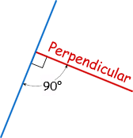
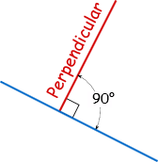
Relations and Functions
5.6: Parallel and Perpendicular Lines
Parallel Lines:
Lines on a plane that never meet. They are always the same distance apart.
Here the red and blue lines are parallel.
Perpendicular Lines:
It means at right angles (90°) to.
The red line is perpendicular to the blue line:

Slide 42
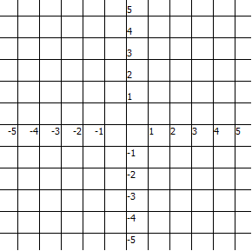
A(2, 1), B(5, 3)
$$m=\frac{1−3}{2−5}=\frac{−2}{−3}=\frac{2}{3}$$
Run = 3
Run = 3
Rise = 2
C(– 2, 2), D(1, 4)
Rise = 2
$$m=\frac{2−4}{−2−1}=\frac{−2}{−3}=\frac{2}{3}$$
Lines that are higher on the right have
a positive slope.
Lines that have equal slopes are parallel
Line AB is parallel to line CD

Slide 43
E(– 3 , 4), F(– 1 , – 2)
$$m=\frac{4−(−2)}{−3−(−1)}=\frac{6}{−2}=−3$$
Run = – 1
G(0, 5), H(1, 2)
Rise = 3
Rise = – 6
$$m=\frac{5−2}{0−1}=\frac{3}{−1}=−3$$
Run = 2
Lines that are higher on the left have
a negative slope.
Lines that have equal slopes are parallel
Line EF is parallel to line GH

Slide 44
J(3 , –2), K(6 , – 4)
$$m=\frac{−2−(−4)}{3−6}=\frac{2}{−3}=−\frac{2}{3}$$
L(4, –3), M(2, –6)
Run = –3
$$m=\frac{−3−(−6)}{4−2}=\frac{3}{2}$$
Run = 2
Rise = 2
Rise = 3
$$−\frac{2}{3}×\frac{3}{2}=−1$$
If the slopes of 2 lines are negative reciprocals
(product = – 1) they are perpendicular.
JK ┴ LM

Slide 45
J(– 5 , –2), K(4 , – 5)
$$m=\frac{−2−(−5)}{−5−4}=\frac{3}{−9}=−\frac{1}{3}$$
Run = 3
L(– 4, – 4), M(– 2, 5)
Rise = 9
$$m=\frac{−4−5}{−4−(−2)}=\frac{−9}{−2}=\frac{3}{1}=3$$
Run = –9
Rise = 3
$$−\frac{1}{3}×\frac{3}{1}=−1$$
If the slopes of 2 lines are negative reciprocals
(product = – 1) they are perpendicular.
JK ┴ LM

Slide 46
R(– 2 , 4), S(5 , 4)
$$m=\frac{4−4}{−2−5}=\frac{0}{−7}=0$$
P(– 3, – 2 ), Q(– 3, 3)
$$m=\frac{−2−3}{−3−(−3)}=\frac{−6}{0}$$
÷ by 0 is undefined
Horizontal lines will always have a slope of zero
Vertical lines will always have a slope which is undefined.
They are also perpendicular

Slide 47
Example #1: For each given line, state the slope of a line that is parallel
and the slope of a line that is perpendicular.
$Remember:$ $y=mx+b$
$$slope=m and y−intercept=b$$
$$y=4x−3$$
$$slope=4$$
$$3x+6y−7=0$$
$$Slope of a parallel line is also 4$$
$$6y=−3x+7$$
$$Slope of a perpendicular line is −\frac{1}{4}$$
$$y=−\frac{3}{6}x+\frac{7}{6}$$
$$y=−\frac{1}{2}x+\frac{7}{6}$$
$$slope=−\frac{1}{2}$$
$$Slope of a parallel line is also− \frac{1}{2}$$
$$Slope of a perpendicular line is \frac{2}{1}=2$$

Slide 48
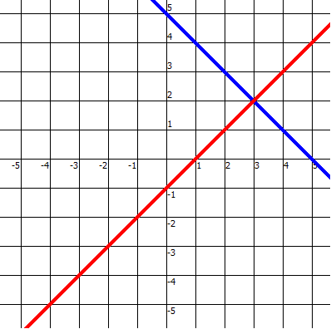
Example #2: Determine if the lines passing though the 2 sets of points are parallel,
perpendicular or neither.
$\left(3, 2\right)$ and $\left(1, 4\right)$ ; $\left(−1, −2\right)$ and $\left(−3, −4\right)$
$$m=\frac{2−4}{3−1}=\frac{−2}{2}=\frac{−1}{1}=−1$$
$$m=\frac{−2−(−4)}{−1−(−3)}$$
$$=\frac{2}{2}=\frac{1}{1}=1$$
Since the slopes are negative reciprocals the lines are perpendicular
$\left(1, 4\right)$
$$m=1$$
$\left(3, 2\right)$
$$m=−1$$
$\left(−1, −2\right)$
$\left(−3, −4\right)$

Slide 49
$$\text{Example}\text{ \#3: }\text{Write} \text{the} \text{equation} \text{of} \text{the} \text{line} \text{perpendicular} \text{to} 3x−2y−12=0$$
$$\text{and} \text{has} \text{the} \text{same} \text{x}\text{−}\text{intercept} \text{as} x−y+4=0$$
Rearrange to $y=mx+b$
Equation
$$3x−2y−12=0$$
$$m=\frac{y_{2}−y_{1}}{x_{2}−x_{1}}$$
$$−2y=−3x+12$$
$$\frac{−2y}{−2}=\frac{−3x}{−2}+\frac{12}{−2}$$
$$\frac{−2}{3}=\frac{y−0}{x−(−4)}$$
$$y=\frac{3}{2}x−6$$
$$\frac{−2}{3}=\frac{y}{x+4}$$
$$Slope is \frac{3}{2}so slope of$$
$$perpendicular line is \frac{−2}{3}$$
$$3y=−2\left(x+4\right)$$
x-intercept y = 0
$$3y=−2x−8$$
$$x−(0)+4=0$$
$$y=mx+b form$$
$$General form$$
$$x+4=0$$
$$y=\frac{−2}{3}x−\frac{8}{3}$$
2$x+3y=−8$
$$x=−4$$
$$Point is (−4, 0)$$

Slide 50
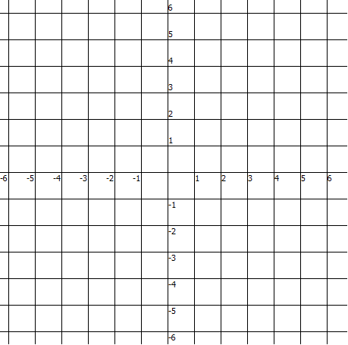
$$\text{Example}\text{ \#3: }\text{Write} \text{the} \text{equation} \text{of} \text{the} \text{line} \text{perpendicular} \text{to} 3x−2y−12=0$$
$$\text{and} \text{has} \text{the} \text{same} \text{x}\text{−}\text{intercept} \text{as} x−y+4=0$$
$$y=\frac{3}{2}x−6$$
$$y=\frac{−2}{3}x−\frac{8}{3}$$

Slide 51
Example #4: A line has points located at $(−3, 5)$and $(4 , a).$What is the value of a if the slope is $−2$? Solve this problem graphically and algebraically.
$$m=\frac{y_{2}−y_{1}}{x_{2}−x_{1}}$$
$$(−2)(−7)=\left(1\right)\left(5−a\right)$$
$$14=5−a$$
$$−2=\frac{5−a}{−3−4}$$
$$a+14= 5$$
$$−14=−14$$
$$\frac{−2}{1}=\frac{5−a}{−7}$$
$$a=−9$$

Slide 52
Relations and Functions
5.7: Applications of Linear Functions
Example #1:
Ernesto needs to rent a paint sprayer. His friend Daniela rented one and paid $15/h plus a fixed charge. Daniela could not remember the fixed charge, but remembered that she rented the sprayer for 4 hours and paid $85.
Determine an equation for the cost to rent the sprayer.
Slope is the rate of $15/h
Point is $(4, 85)$
$$m=\frac{y_{2}−y_{1}}{x_{2}−x_{1}}$$
$$1(y−85)=15\left(x−4\right)$$
$$y−85=15x−60$$
$$15=\frac{y−85}{x−4}$$
$$y−85=15x−60$$
$$+85 = +85$$
$$\frac{15}{1}=\frac{y−85}{x−4}$$
$$y=15x+25$$

Slide 53
b) How much would Ernesto have to pay if he rented the sprayer for 10 hours?
$$y=15x+25$$
$$or C=15t+25$$
$$C=15(10)+25$$
$$C=150+25$$
$$C=175$$
Ernesto would have to pay $175 for 10 hours

